Slide 1
NLP - SENTIMENT ANALYSIS
Name: Vimaleswar A
Roll No: 20305
Instructor: Dr. Bhavna Rajasekaran

Slide 2
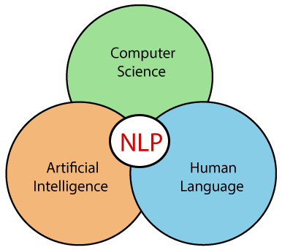
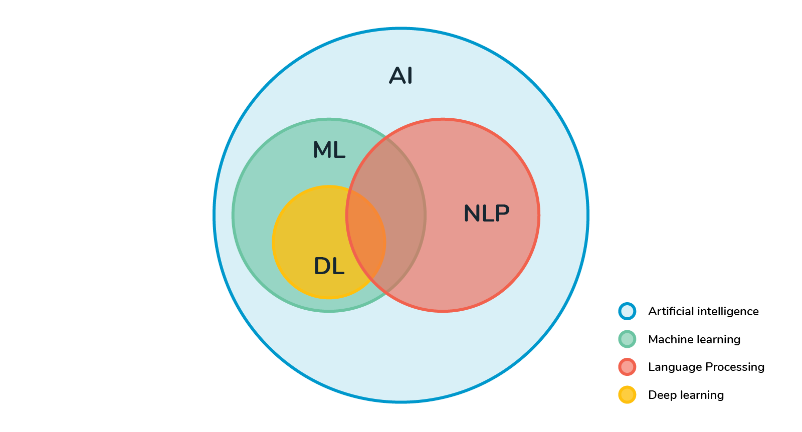
What is NLP?
Natural Language Processing (NLP) refer to the branch of Artifical Intelligence that allows machines to understand human language. The goal of NLP is to enable computers to understand, interpret and generate human-like text in a way that is both meaningful and contextually relevant. NLP involves a range of tasks and challenges, including:
Speech Recognition: Converting spoken language into written text. Eg: Google Assistant, Alexa etc.
Question Answering: Developing systems that can understand and respond to questions posed in natural language. Eg: Chatbox, ChatGPT etc.
Text Summarization: Creating concise and informative summaries of longer text.
Sentiment Analysis: Determining the sentiment expressed in a piece of text (positive, negative, neutral). Eg: Zomato, Amazon etc.
Machine Translation: Automatically translating text from one language to another. Eg: Google Translate etc.

Slide 3
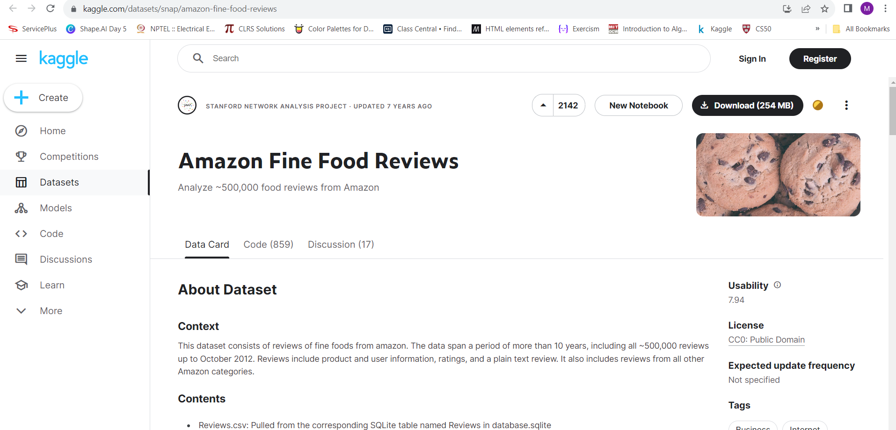
Sentiment Analysis on Amazon Fine Food Reviews
Data includes: 1. Reviews from Oct 1999 - Oct 2012 2. 568,454 reviews 3. 256,059 users 4. 74,258 products 5. 260 users with > 50 reviews

Slide 4
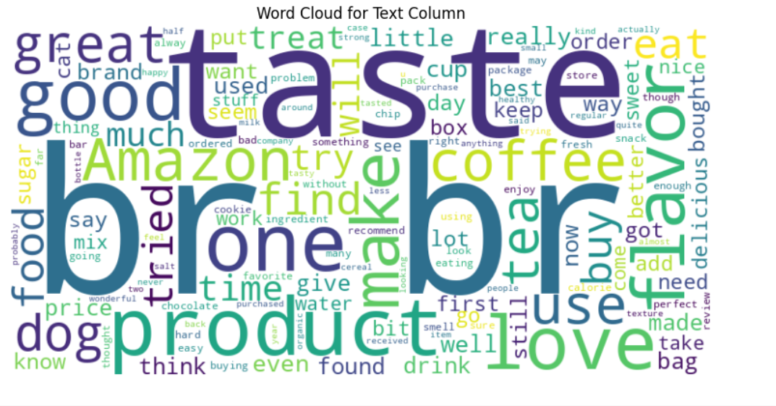
Exploratory Data Analysis (EDA)
It is an approach to analyzing data sets to summarize their main characteristics, often with the help of statistical graphics and other data visualization methods. It’s primary goal is to gain insights into the underlying patterns, relationships and structure within the data. Some of the EDA techniques which we used for our dataset are discussed below:
Word Cloud for text column
Visualize the most frequent words in the “Text” column. It provides a graphical representation of word frequency. Larger and bolder words appear frequently in the text.

Slide 5
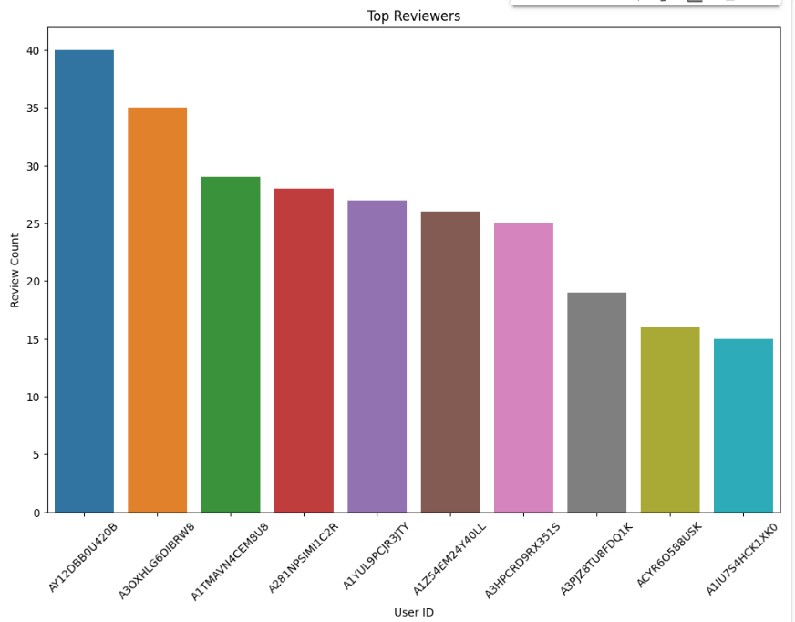
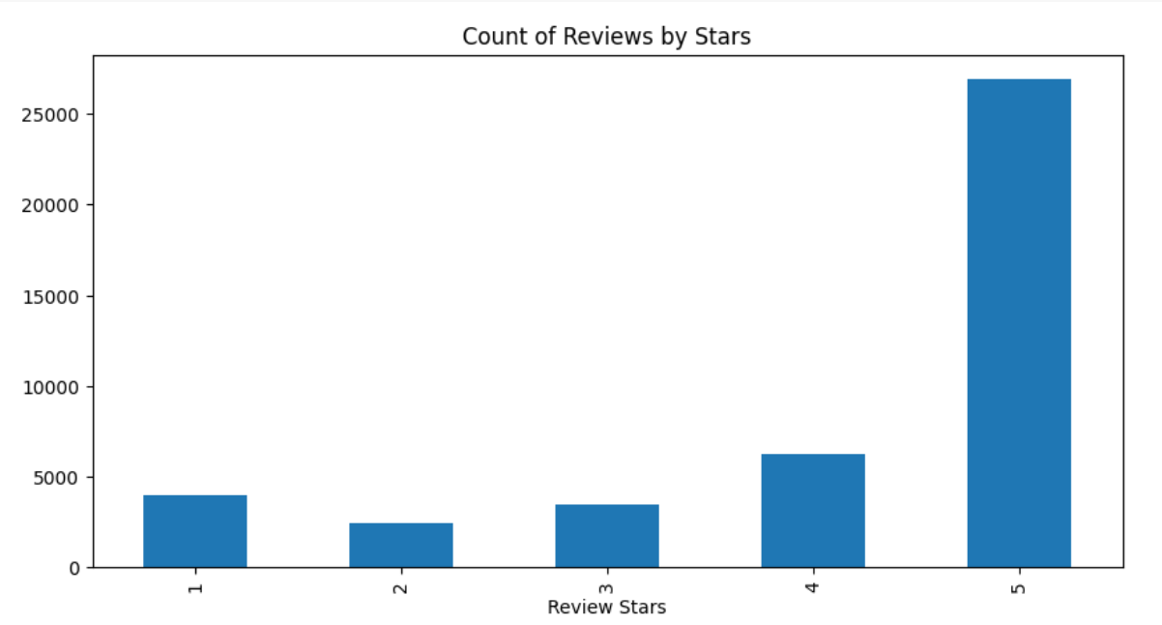
Bar plot
Bar plots are commonly used to display the frequency distribution of categorical variables. Here we have done a bar plot User ID in x-axis and Review count in y-axis
Count plot
It displays the count of observations in each category of a categorical variable using bars. This is for visualizing the frequency of different categories. Here we have done a count plot to visualize the number of score (star review)

Slide 6
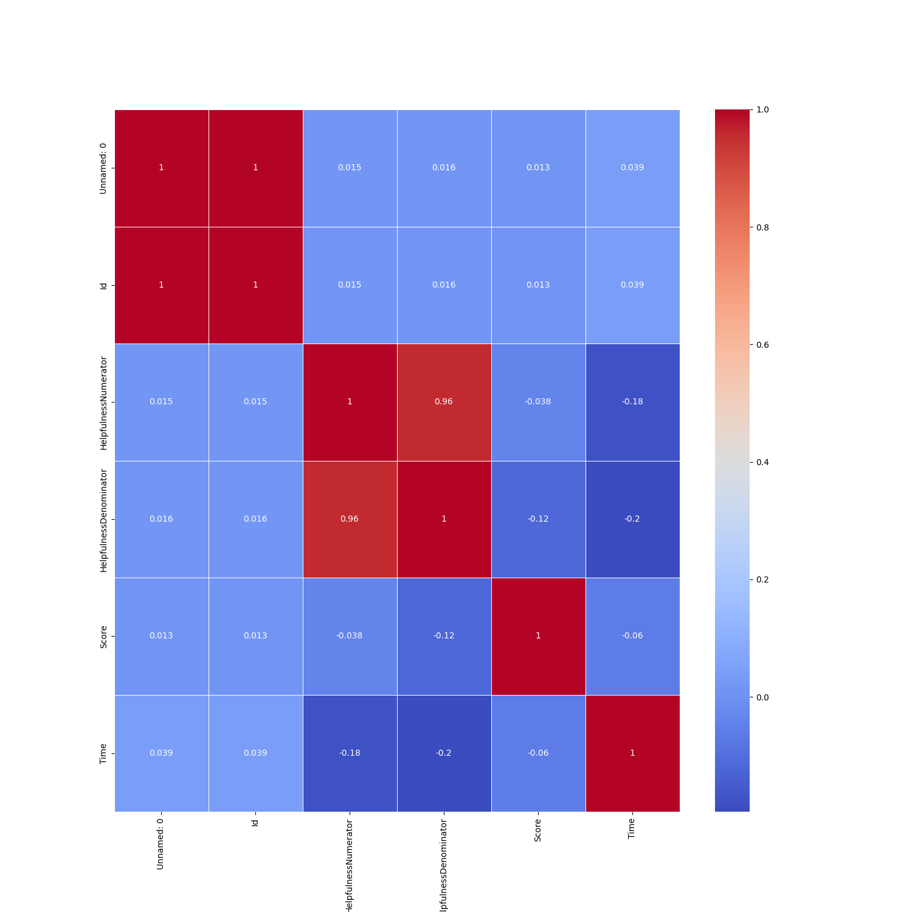
Heatmap for Correlation
Here, we have explored the correlation between the all columns in the dataset. It helps in understanding the correlation between different column and which column is highly correlated to score.

Slide 7
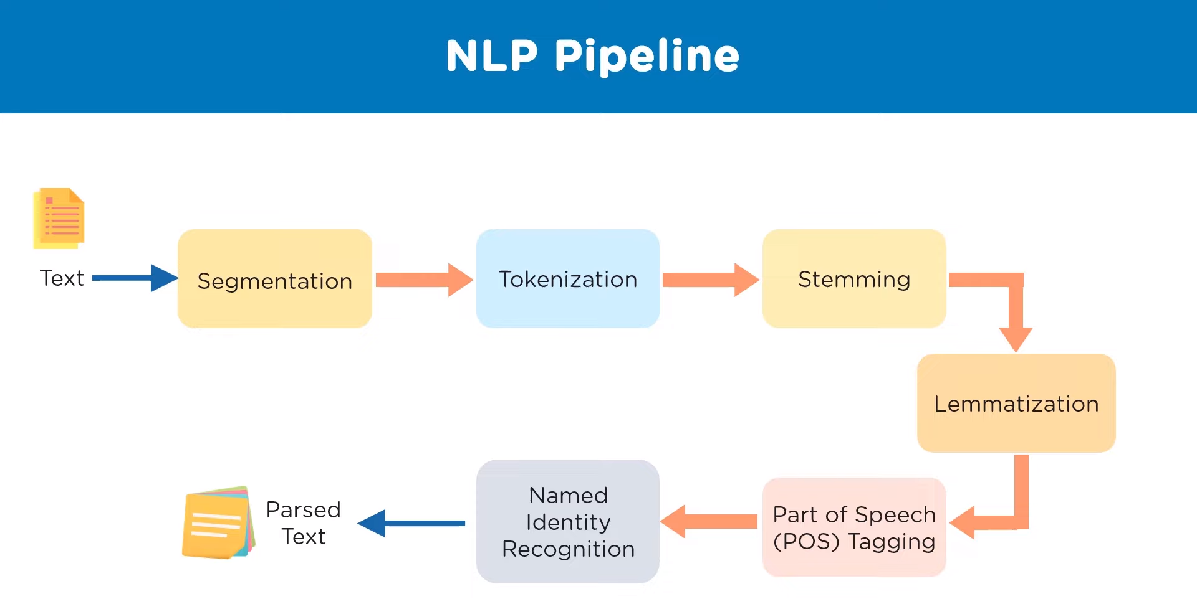

Slide 8
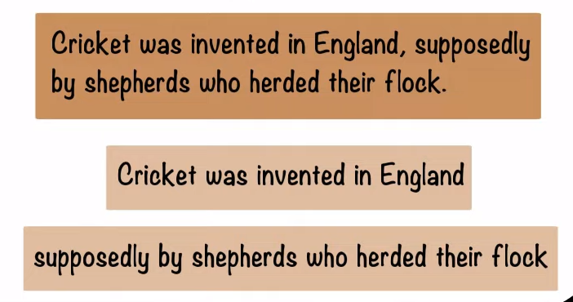
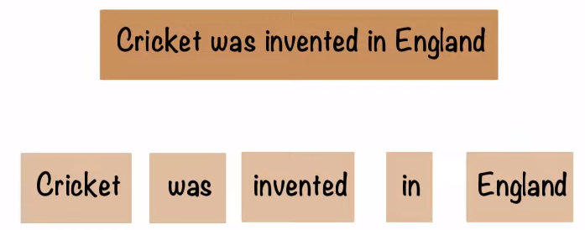
Segmentation
The process of dividing a sentence into its component sentences, usually along punctuation. It helps in analyzing the structure of the text at the sentence level.
2. Tokenization
The process of splitting sentences into their constituent words is called Tokenization. It plays a crucial role in converting text into a format that is suitable for analysis by machine learning models.

Slide 9
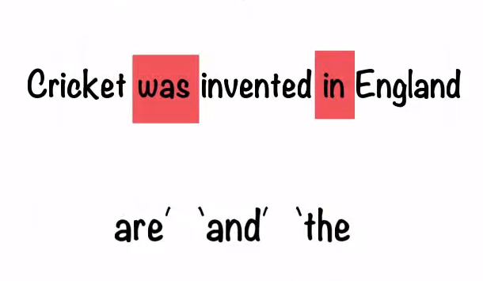
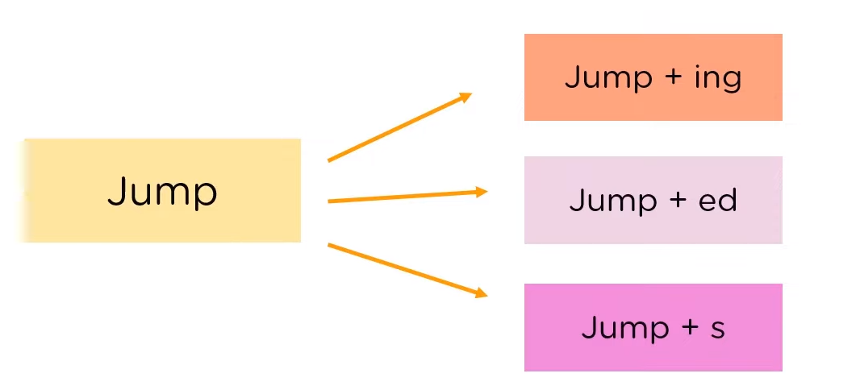
3. Stop words
Stop words usually do not carry much semantic meaning on their own. By removing them, the emphasis can be placed on the more content-rich word that contribute to the overall meaning of the text.
4. Stemming
The stemming is the process of reducing word to their base or root form, called the stem. The purpose of stemming is to reduce inflected or derived words to a common base form, which helps in various text processing tasks

Slide 10
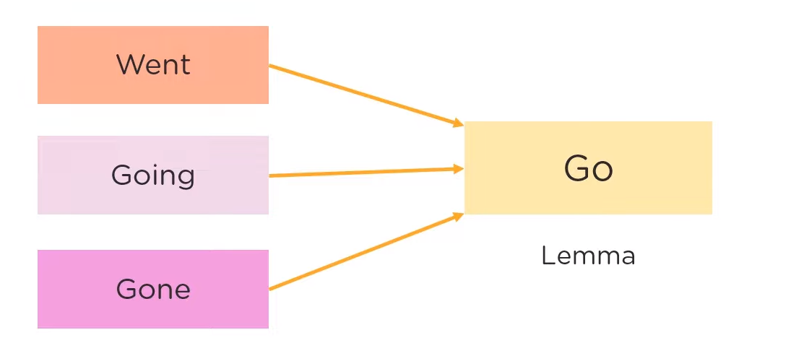
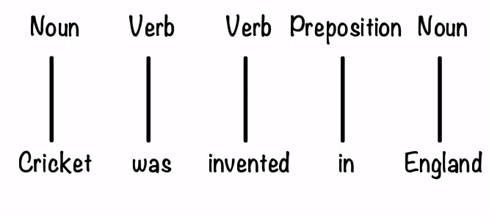
5. Lemmatization
Lemmatization is the process of reducing words to their base or root form, known as the lemma, which is the valid word. Unlike stemming, which involves removing prefixes or suffixes to obtain a word’s root, lemmatization considers the context and morphology of words to produce a meaningful base form.
6. Part of Speech (POS) Tagging
POS is a fundamental task in NLP that involves assigning grammatical categories, or parts of speech, to words in a given text.

Slide 11
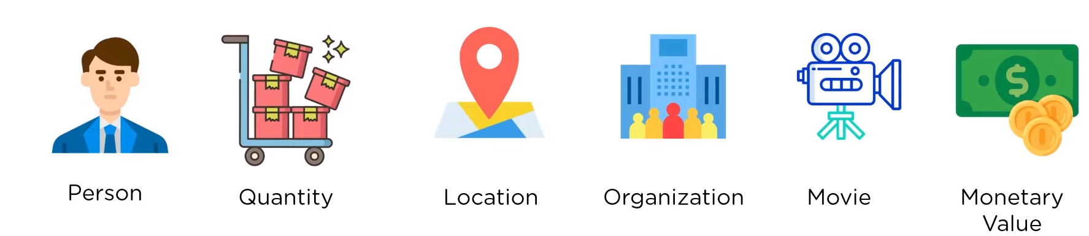
7. Named Entity Recognition (NER)
NER involves identifying and classifying named entities (i.e., specific entities or objects) in text into predefined categories such as person names, organizations, locations, dates, numerical values and more.

Slide 12
Algorithms
Long Short-Term Memory (LSTM)
LSTM networks are a type of recurrent neural network (RNN) architecture that has proven to be effective in capturing long-term dependencies in sequential data. In sentiment analysis, the order of words in a sentence carries important information about the sentiment expressed. The LSTM does have the ability to remove or add information to the cell state, carefully regulated by structures called gates. Gates are a way to optionally let information through. They are composed out of a sigmoid neural network net layer and a pointwise multiplication operation. An LSTM has three gates, to protect and control the cell state. In sentiment analysis, bidirectional LSTMs are often used. These models process the input sequence both forward and backward, allowing them to capture contextual information from both directions. This is crucial for understanding the sentiment in a sentence where the meaning can depend on the entire context. In more complex sentiment analysis tasks or for deeper modeling, multiple LSTM layers can be stacked on top of each other.

Slide 13
Methodology
We have a dataset of 10 columns and 103373 rows with some null (NaN) values in it. We dropped the entire row containing the null values using dropna() function from numpy. We perform EDA (Exploratory Data Analysis ) and plotted some graph as discussed before and get some insights about the dataset. Then, we took a random sample of 43000 rows, as the dataset of 1 lakh rows takes more computational time and space. We tokenized the “Text” column using BERT Tokenizer and named it as “text_token” column. We split the text_token column and target value i.e., Score column into 80 % of training dataset and 20% as test / validation dataset. Then, we perform one-hot encoding on score label to convert into vector as the the class is imbalance. Now, we pads the sequence in uniform length (max length 512). Padding is necessary in LSTM because not all the sentences have the same length. LSTM take inputs of the same length and dimension, so input sequences are padded to maximum length while testing and training. We made a Sequential Neural Network model with an embedding layer. The embedding layer is crucial in NLP tasks as it helps the model learn a meaningful representation of words in a continuous vector space, capturing semantic relationships between words. Next, we add a LSTM layer, fully connected dense layer with dropout with Sigmoid activation function and a softmax output layer to the neural network model. Next, the model is compiled with the Adam optimizer and categorical cross-entropy loss. We calculate the loss and accuracy.

Slide 14
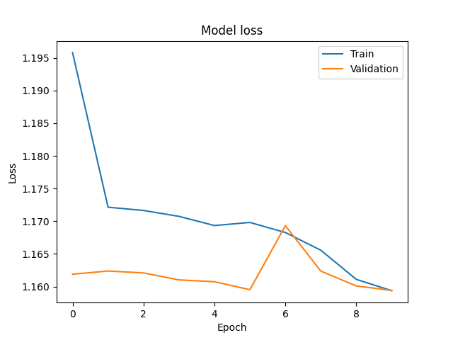
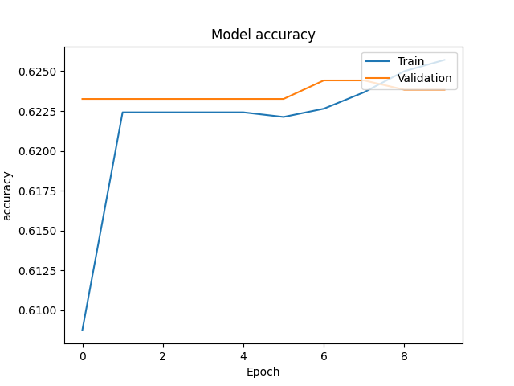
Result

